Slide 1















Team & Problem Statement
KisanBazaar
From Crop to Best Market
Scope
KisanBazaar
All MP districts
All crops grown in MP
Hindi and English
Android application
From Crop to Best Market
PS-10 Farm-to-Market Intelligence Platform
TRACK 05
KisanBazaar helps farmers
find a better place to sell their crops.
TEAM: HACK HORIZON
Adnan Khan
Tushar Soni
Shranshikhha Somkuwar
Farmer
KisanBazaar
Best selling option

Slide 2

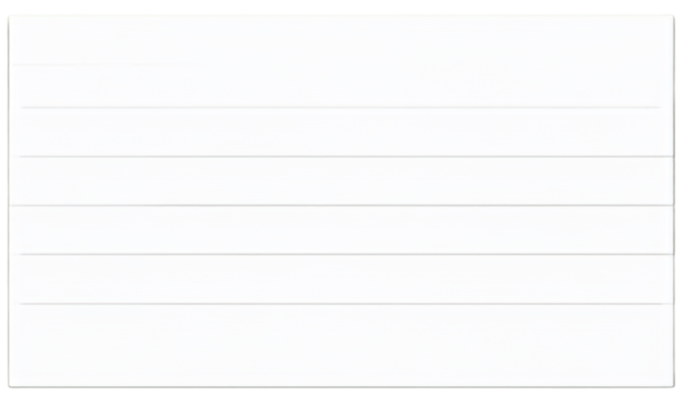











Problem Understanding
Example for 100 quintals of crop
Farmers can see crop prices, but price alone does not show which option gives them more money.
Calculation
Buyer A
Buyer B
Price per quintal
₹2,300
₹2,250
Quantity
100 qtl
100 qtl
Main Problems
People Involved
Gross amount
100 × ₹2,300 = ₹2,30,000
100 × ₹2,250 = ₹2,25,000
Price info from many places
Farmers
Transport charge
− ₹12,000
− ₹3,000
Transport can cost a lot
Buyers
Final amount
₹2,30,000 − ₹12,000
= ₹2,18,000
₹2,25,000 − ₹3,000
= ₹2,22,000
Some buyers pay late
Mandis
Some buyers can’t buy full crop
Warehouses
Storage costs and crop loss risk
Transport providers
Buyer A has higher price per quintal
Buyer B is the better option because the farmer receives ₹4,000 more.
Old info can cause wrong choice
Government procurement teams
Buyer B has lower transport cost
Government selling steps are hard
Buyer B gives ₹4,000 more
(₹2,22,000 - ₹2,18,000 = ₹4,000)
Price alone does not show the full money in the farmer’s pocket. We must compare all costs to choose the best option.

Slide 3





















Proposed Solution
KisanBazaar compares all selling options and
shows which option may give the farmer the best result.
1. FARMER ENTERS
2. KISANBAZAAR CHECKS
3. KISANBAZAAR COMPARES
4. FARMER GETS
Crop Quantity District Harvest date Selling deadline Money needed
Mandi prices
Buyer offers
Government buying
Transport cost
Warehouse cost
Final amount
Payment time
Buyer capacity
Data date
Storage risk
Best option
Full cost calculation
Reason
Warning about old/missing data
Next action
EXAMPLE RESULT
The farmer checks the details and makes the final decision.
Recommended option:
Buyer B
Estimated final amount:
₹2,22,000
Reason:
The farmer gets ₹4,000 more after transport.
The app gives an estimate.
It does not promise a price or profit.

Slide 4








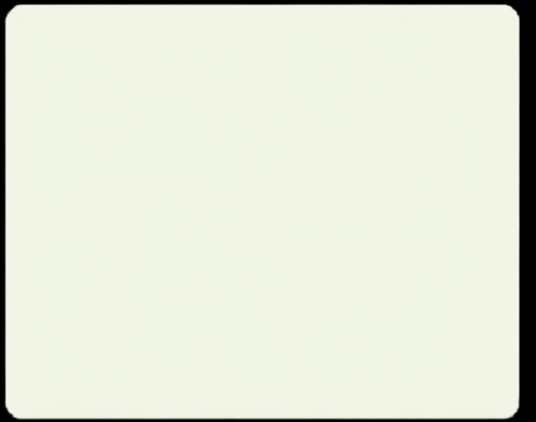






Key Features & Innovation
KisanBazaar does more than show crop prices.
It calculates how much money the farmer may receive after costs.
Market Information
Buyer Search
Transport Cost
Shows mandi prices, old records, 7/30/90–day changes, data date/source, MSP where applies
Shows buyers, price, required quantity, distance, payment time,
offer end date
Shows transport/handling costs, vehicle capacity check, final amount after transport
Key Differences
Covers all MP districts
Covers all crops grown in MP
Checks price, cost and payment time together
Warehouse Search
Government Procurement Help
Kisan Assistant
Explains every result
Shows warehouses, distance, available space, storage cost, price to cover storage
Shows MSP and schemes, who can apply, selling steps, official government
page link
Hindi & English, simple questions, explains options, supports text,
touch, speech
Shows storage risk without promising future price
Separates market prices from real buyer offers

Slide 5


























Technology & Implementation
KisanBazaar uses free and open tools,so the project does not need paid software services.
System Architecture
Technology Stack
Implementation Approach
Government and Market Data + Buyer, Warehouse and Transport Data
React Native and Expo
Build the Android app
Complete MP data available from start
Write safer app code
Data covers all MP districts and crops
TypeScript
Data Check
App loads only needed data to save storage and mobile data
Supabase
and PostgreSQLSQL
Store and manage data
Supabase Database
Keeps recent data for weak internet areas
Supabase Auth
Manage user login
KisanBazaar Calculation System
Database security rules
Protect user info
Shows source and date for every price
Android App
Government and authorized sources
Provide data
User info protected
Android APK and AAB
Test and publish app
Avoid paid dependencies
Selling Options for the Farmer
no paid AI API, SMS OTP, map API, hosting, cloud-build
Google Play
Distribute app

Slide 6
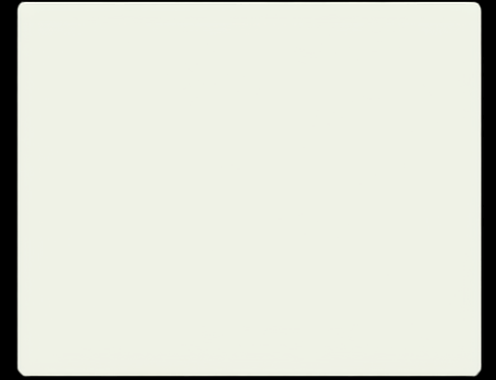






Impact, Feasibility & Future Scope
Expected Impact
Feasibility
Future Scope
Uses free and open-source tools
Uses existing Android phones and computers
Uses complete authorized data from start
Works with weak internet
No paid AI services needed
Can use existing Google Play developer account
Support Farmer Producer Organizations
Improve road and transport cost estimates
Add farmer-approved price alerts
Add more regional languages
Add verified buying and delivery steps
Expand to other Indian states
Study future price trends after testing
Farmers can compare selling options easily
Farmers see important costs
Farmers understand payment time
Farmers understand government selling steps
Farmers make better-informed choices
App supports all MP districts and crops
“KisanBazaar helps farmers compare prices, costs and payment time before they sell.”
Right crop. Right market. Better-informed decision.
External tools and data references include Android, React Native, Expo, Supabase, PostgreSQL, data.gov.in/AGMARKNET, e-NAM, official government procurement sources, Material Symbols or Font Awesome, and Google Play. Logos belong to their respective owners. These references do not mean official endorsement.

